Slide 1


Predicting Workers Compensation Claims
With Math!
...and R
By Chris King

Slide 2
Introduction
Workers’ compensation is a critical component of employment, to ensure that both employees have financial security if they are hurt on the job and businesses do not get sued in the case of injury.
The Insurance Companies that provide Workers Comp to businesses, therefore serve a critical role in keeping the economy stable
However, reliably predicting how much will be paid out in a Compensation Claim is a very difficult task. Without being able to predict the amount of workers’ Compensation paid, insurance companies are forced to raise their premiums and pass the cost down to the business and employees in order to hedge this unknown. Without taking such steps, Insurance companies would be assuming too much risk to stay in business for long.
Therefore, the task of predicting Compensation claims is critical to keeping insurance companies in business, keeping prices at a competitive level, and preventing unreasonably high premiums from being passed on to businesses.
Notes:
Workers' comp is important to first ensure employees are not left out to dry if they get injured, as well as protect businesses from being sued if an employee gets injured. However, with the abundance of injury attorneys it is likely that workers comp is more beneficial to businesses than it is to employees

Slide 3
Research Question
The question at hand is to identify if the Compensation claim can be predicted with several explanatory variables, including the employee’s age, gender, hourly pay, marital status, and whether the patient has any dependents
These findings may be useful for:
Building a model estimating the amount of money paid out if a worker’s compensation claim is filed.
Helping insurance companies and businesses accurately understand the risk and potential cost of hiring a new employee
Help insurance companies minimize risk when providing workers’ compensation insurance for a cohort of employees, ensuring prices remain at a competitive level
Clarification:
The aim of this is to predict what the claim amount would be, assuming a claim is filed. This does not seek to find the likelihood of an employee filing a claim.
This also seeks to predict the claim amount proactively, before any injury has occurred.
Further Research:
Further research should be done to predict the likelihood of an employee filing a claim, as well as predicting the claim amount after an injury has occurred, as this would likely include more information to more accurately predict the claim amount
Businesses may also use these findings to identify what jobs have the highest claims, this likely correlates with the severity rate
Notes:
The goal is to predict the amount that would be paid out in a workers comp claim, before any injury has occurred and assuming that an injury will occur. This does not address the probability of a claim being filed, and although a prediction made after the injury is likely more accurate, as in my initial data the initial payout was the greatest predictor of final payout, this is less actionable.

Slide 4
Data Description
The initial dataset includes the above variables along with some useless variables for 54,000 individuals.
A few more variables I created are:
Average workday, which is hours worked per week divided by the number of days worked
Hourly pay, which is weekly wages divided by hours worked per week
Time to report in hours, which was the difference between the time of the accident and the date reported
Total dependents, which is the number of child dependents + the number of other dependents
This dataset included a mix of continuous and binary variables, with the outcome variable being continuous

Slide 5
Data Cleaning
Data cleaning began with creating the new columns mentioned above.
Next, rows with unknown and implausible values were removed.
This includes removing rows in which:
The average working day is longer than 24 hours
The number of hours worked is zero
The gender and marital status are unknown.
Every column in the dataframe is also converted to numeric, to more easily work with the data.
Data is sorted into continuous and binary variables, with a total of 10 Continuous, 4 binary Before variable selection and 2 continuous, 3 binary variables After variable selection
binary variables are encoded to 0 and 1
Gender: Female = 0, Married = 1
Marital status: Single = 0, Married = 1
Has dependents: none = 0, one or more = 1
Notes:
Data selection was done through the correlation matrix, data visualizations, chi-square, and 2-sample Wilcox rank sum test, as well as modeling trial and error. I began the data cleaning with roughly 14 variables, after removing variables because of redundancy and collinearity, having no correlation and no significant effect on the outcome variable, etc.

Slide 6
Summary Statistics
The trimmed claim cost has the top 1% and bottom 1% removed, to better understand how the data is affected by outliers
 | Min | 1st Q | Median | Mean | 3rd Q | Max | Skew | Kurtosis
Log Claim Cost | 2.08 | 2.9 | 3.5 | 4.02 | 3.9 | 6.6 | 0.31 | -0.35
Claim Cost | 122 | 869 | 3,104 | 10,459 | 7,760 | 4,027,136 | 41 | 4441
Claim Cost (trimmed) | 205 | 892 | 3,104 | 8,399 | 7,624 | 133,893 | 4 | 19.7
Hourly Pay | 0.025 | 5.263 | 10.316 | 11 | 13 | 252 | 9.33 | 219
Age | 13 | 23 | 32 | 34 | 42 | 80 | 0.55 | -0.6
From these values, we can deduce that the Claim cost and hourly pay are likely not normally distributed, with very high Skew and Kurtosis scores.
The claim cost is mostly concentrated between 800-7,800 with some extreme outliers
Notes:
Here we can see the claim cost is extremely skewed, skewness is length of tail, kurtosis is peak. High kurtosis is more peaked vs normal distribution

Slide 7
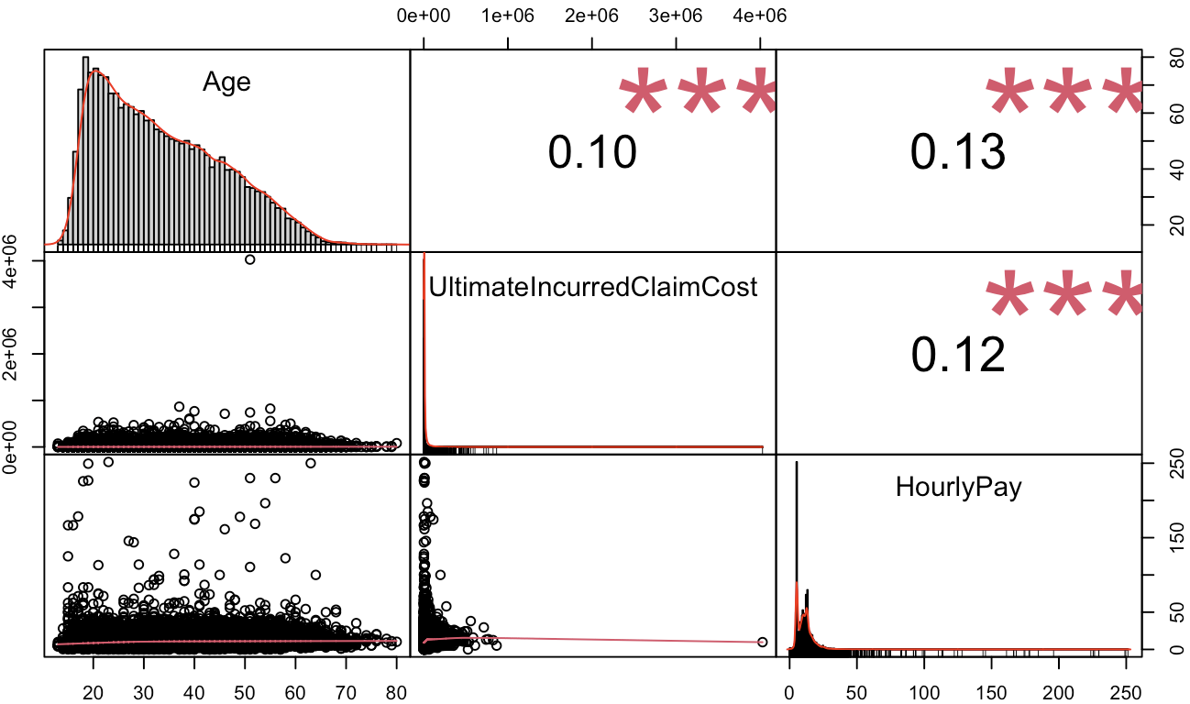
Correlation Analysis
The correlation matrix is used to see if any correlation exists between the continuous variables and the Claim Cost.
Here we see there is a weak positive correlation between Claim Cost and both age and hourly pay, but there is also
some correlation between Age and hourly pay suggesting the possibility of some collinearity between the 2 variables.

Slide 8
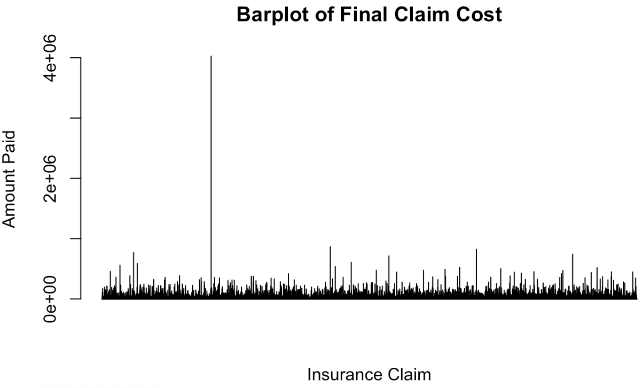
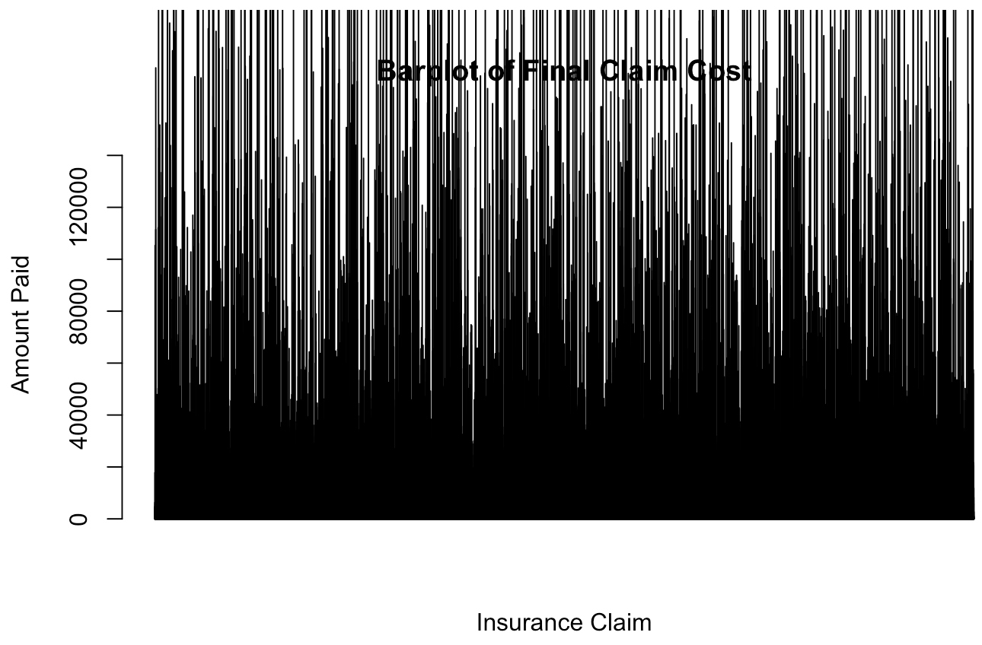
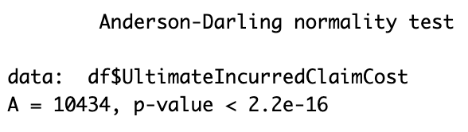
Final Claim Cost
Here, we see the presence of a massive outlier of ~$4M that greatly distorts the graph. To overcome this, the y limit is set
To $15,000 in order to get a more accurate view of the data, with the sacrifice of excluding the top ~20% of the dataset.
The Anderson-Darling Normality test is used to estimate if the data is normally distributed, with a null hypothesis that the
Data is normally distributed; the alternate hypothesis is that the data isn’t. Based on the visual and AD test results, we see the
Claim cost is not normally distributed.
Because of this, we will use Wilcox rank sum test rather than a t-test when comparing the Claim Cost to binary variables

Slide 9
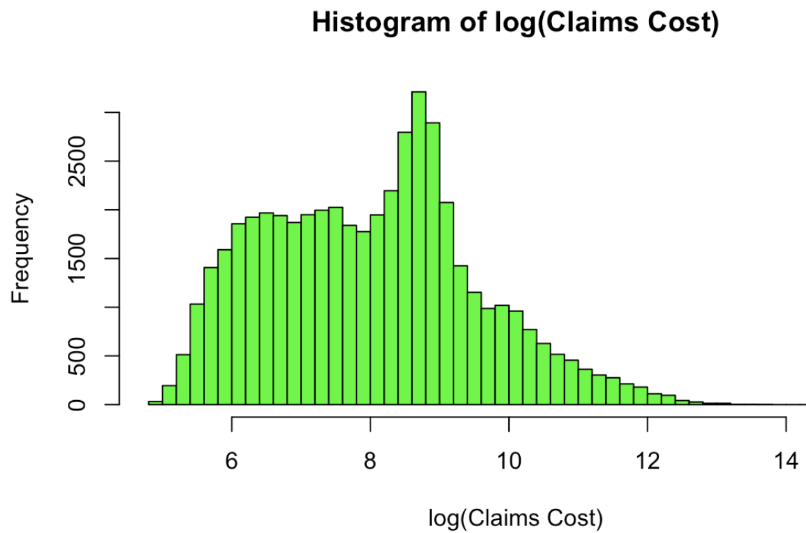
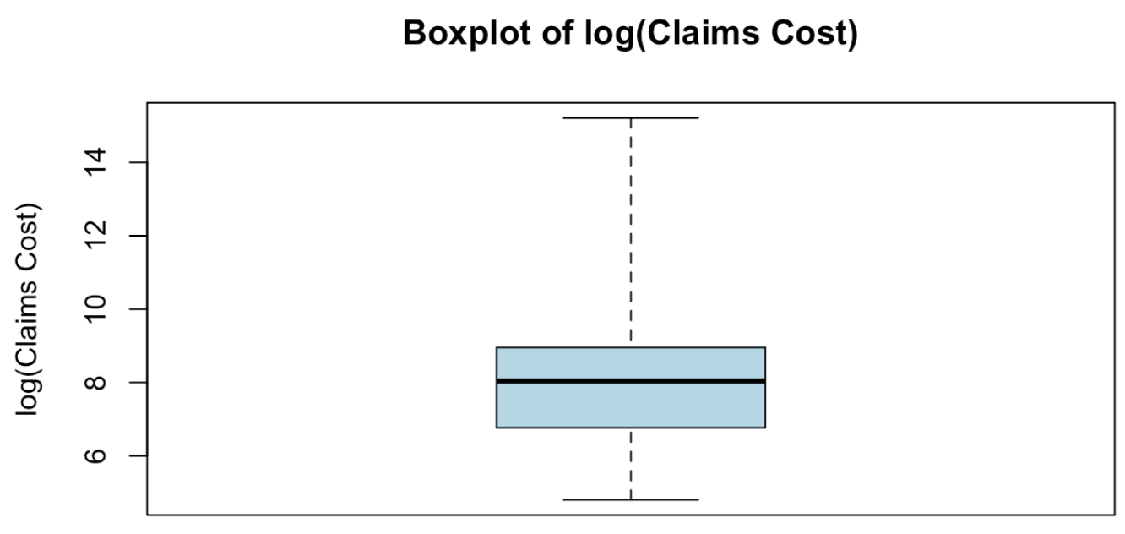
Log transformed Final Claim Cost
Because the Claim Costs are not normally distributed and have extremely large outliers, the data is Log-transformed to stabilize the Cost to be more linear and reign in outliers. The log-transformed data can also be used in modeling, however, the results will need to be converted out of log form to be useful.

Slide 10
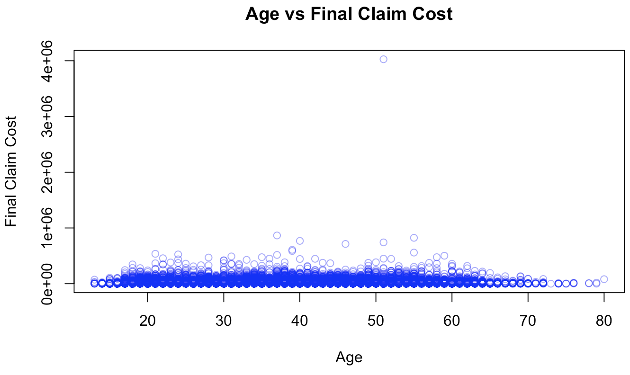
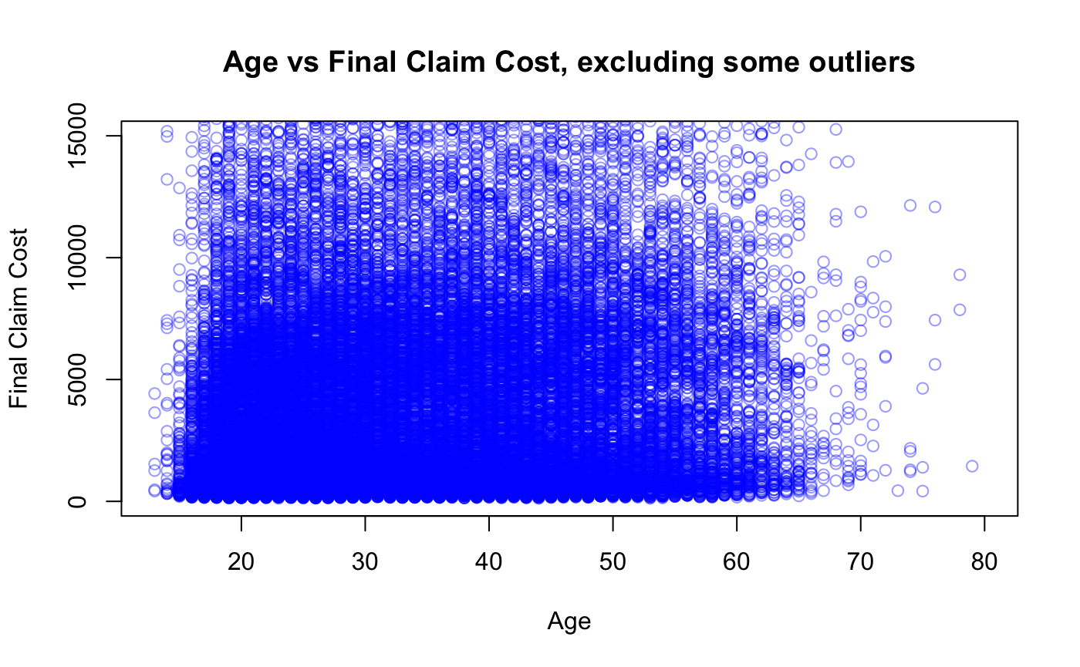
Age
The zoomed-in scatterplot better represents the data because of extreme outliers, at the cost of excluding roughly 20% of the dataset.

Slide 11
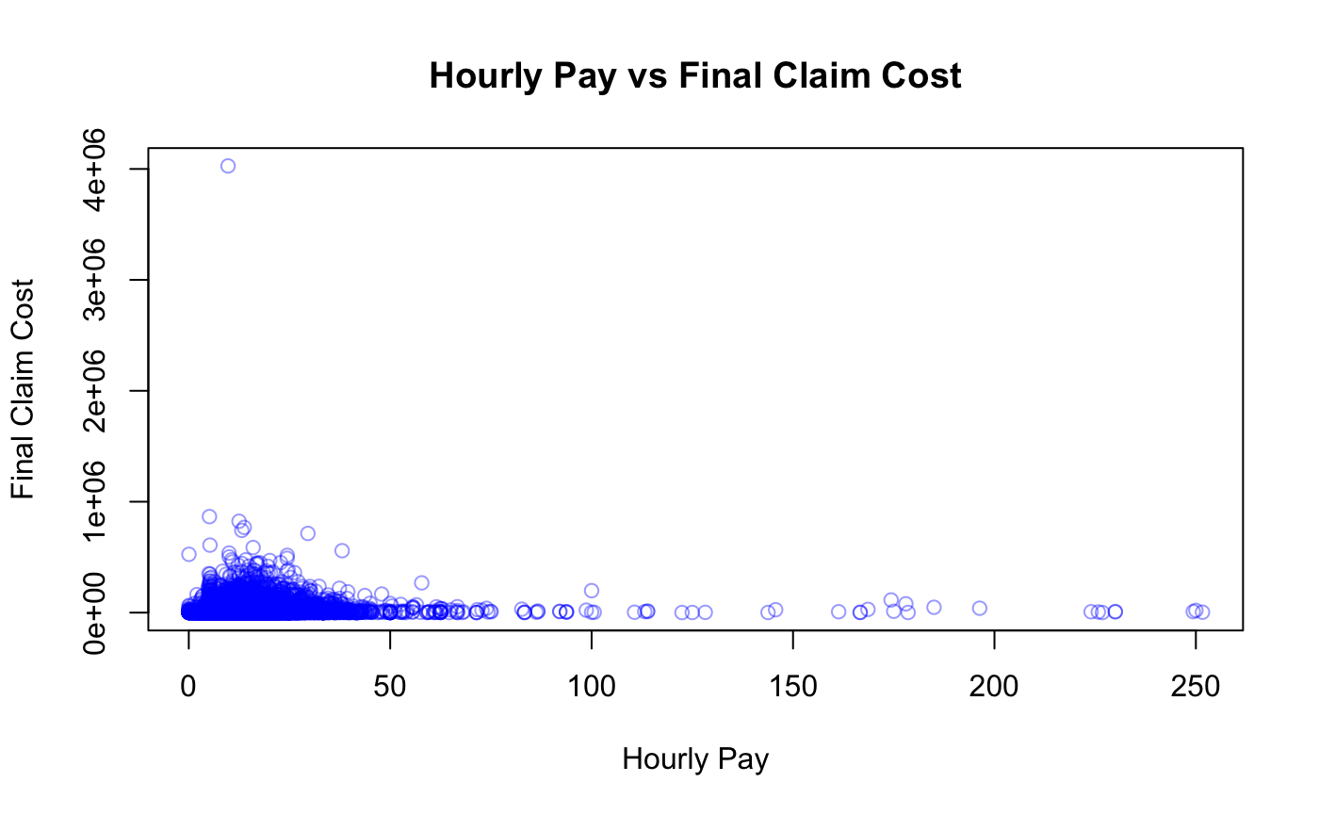
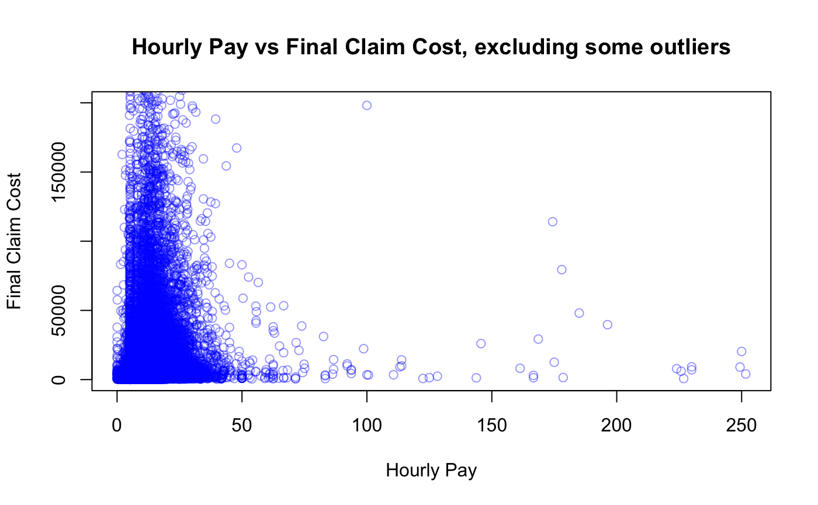
Hourly Pay
Again, The zoomed-in scatterplot better represents the data because of extreme outliers, at the cost of excluding roughly 20% of the dataset.

Slide 12
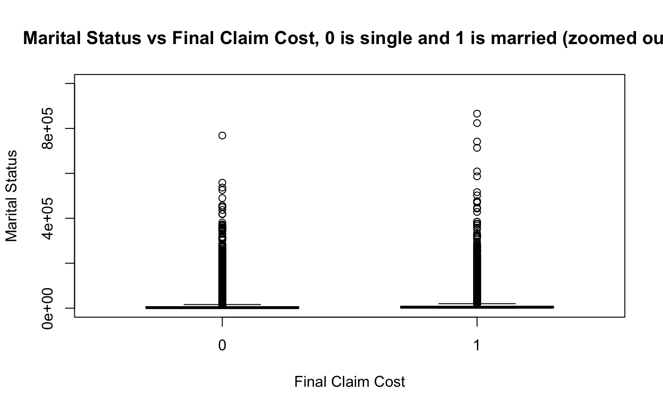
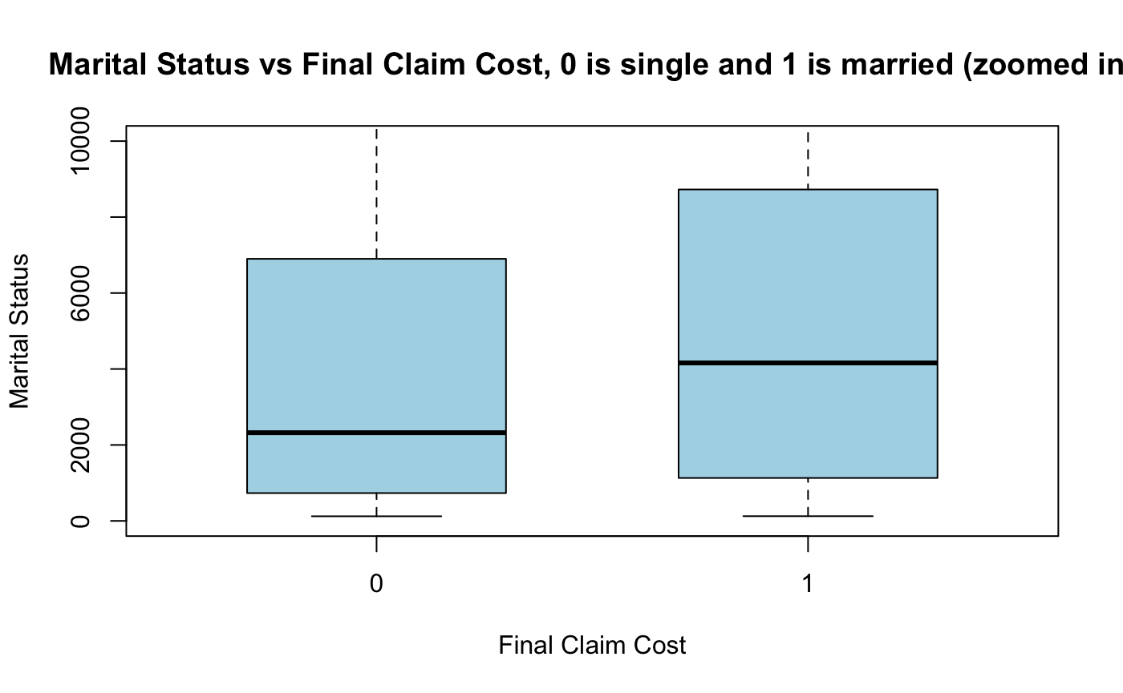
Marital Status
The Box and Whisker plot is used to compare Final Costs for single vs married individuals.
Here we see there is some variation, and it appears that married individuals have a higher Cost than single individuals.
Correlation tests will also be done in the next slide to confirm this.

Slide 13
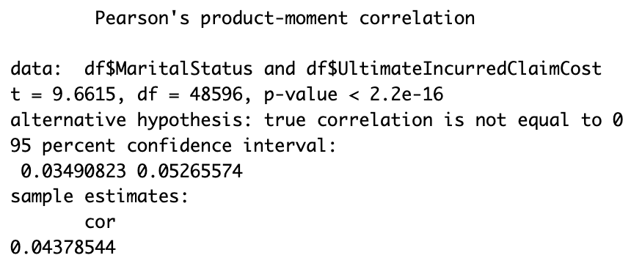
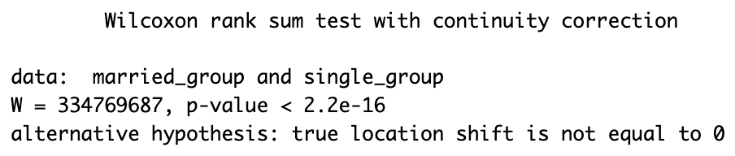
Continued
The Pearson Product Moment Correlation measures the linear relationship between 2 variables and our coefficient of 0.0437 indicates a very weak positive correlation between Married and Single groups, implying marital status may play a minor role in modeling the Claim Cost
The 2-Sample Wilcox Rank Sum test is a non-parametric test, comparing the medians of 2 groups. Based on the results, we can be very confident that the medians of married and single groups are different, and the variable is worth considering in modeling

Slide 14
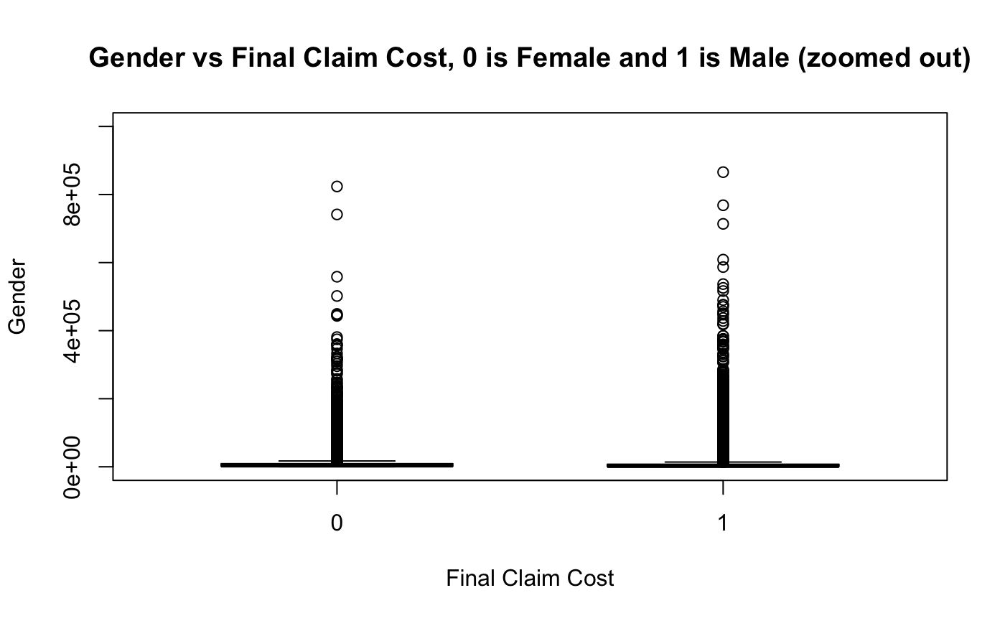
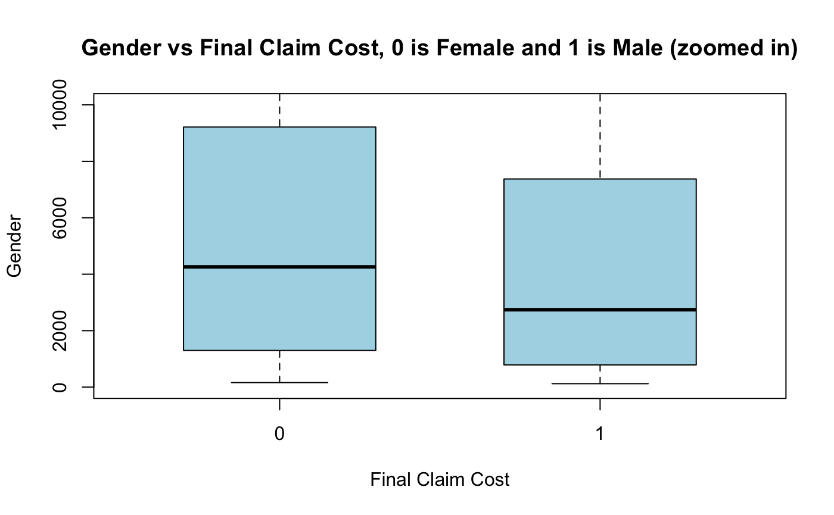
Gender
The Box and Whisker plot is used to compare Final Costs for Female vs Male individuals. Here we see there is some variation, and it appears that females have a slightly higher cost than males.
Correlation tests will also be done in the next slide to confirm this.

Slide 15
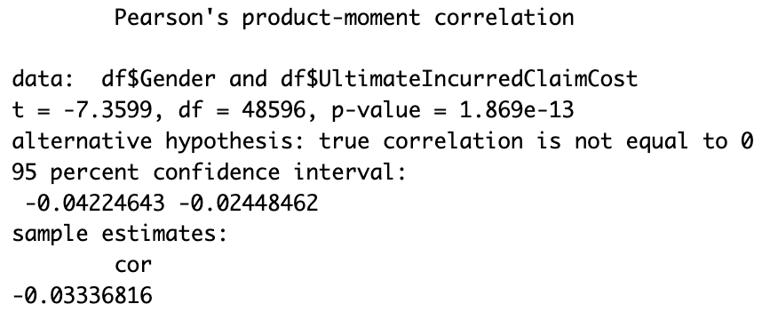
Continued
The Pearson Product Moment Correlation measures the linear relationship between 2 variables and our coefficient of -0.0333 indicates a very weak negative correlation between Male and Female groups, implying Gender may play a minor role in modeling the Claim Cost, and should be included in the modeling portion

Slide 16
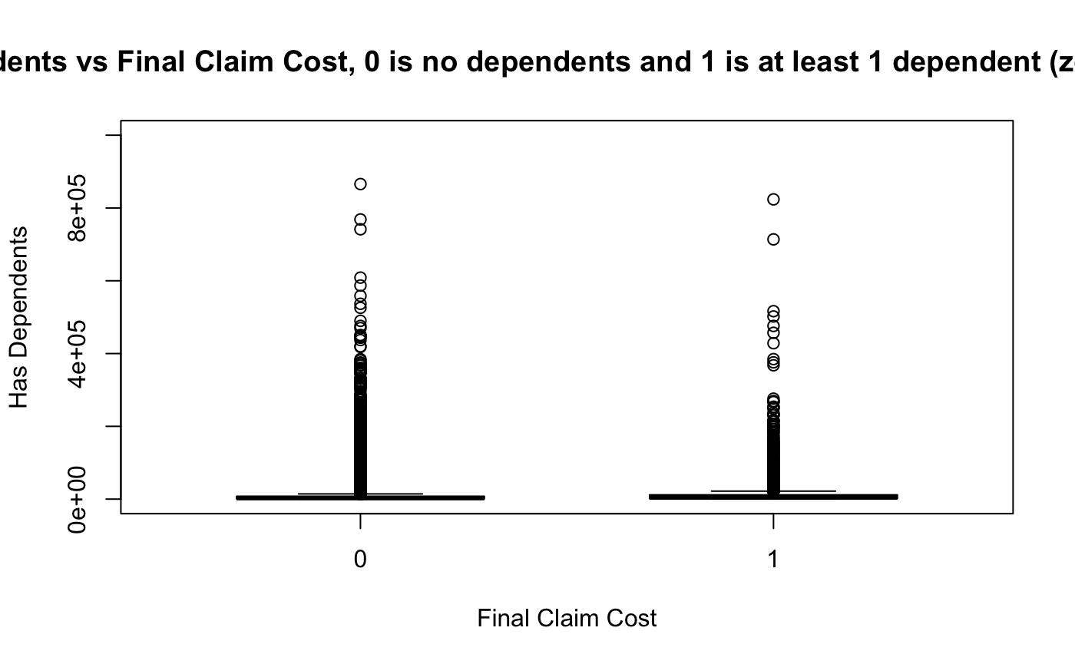
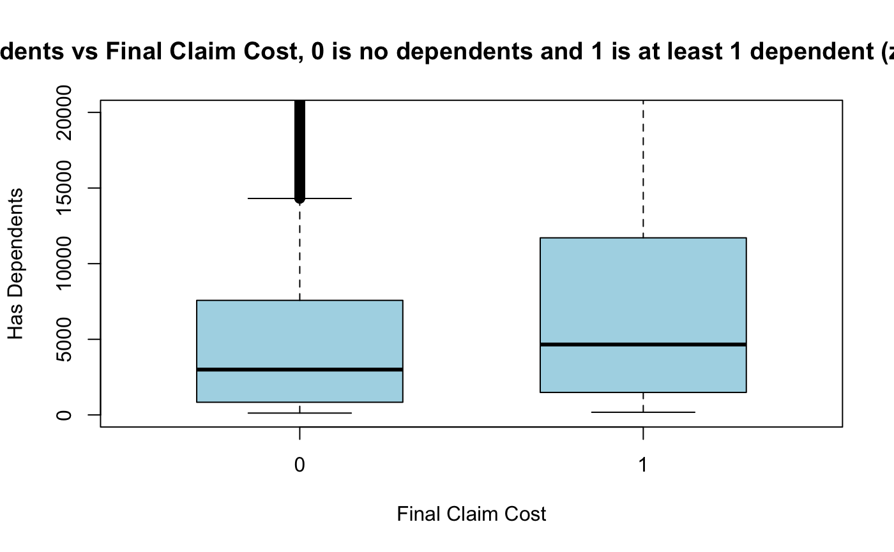
Dependents
The Box and Whisker plot is used to compare Final Costs for Individuals with dependents vs Without dependents. Here we see there is some variation, and it appears that those with dependents have a greater median and upper quartile, with a shorter tail and less extreme outliers
Correlation tests will also be done in the next slide to confirm this.

Slide 17
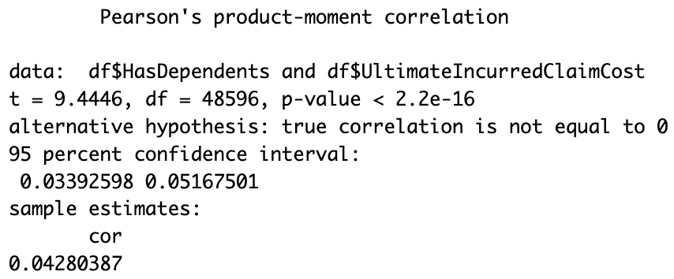
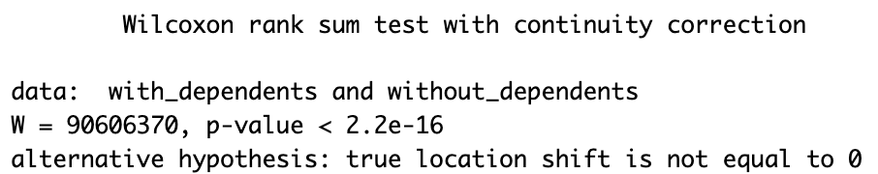
Continued
The Pearson Product Moment Correlation measures the linear relationship between 2 variables and our coefficient of 0.0428 indicates a very weak positive correlation between individuals with and without dependents, implying this may play a minor role in modeling the Claim Cost
The 2-Sample Wilcox Rank Sum test is a non-parametric test, comparing the medians of 2 groups. Based on the results, we can be very confident that the medians of groups with and without dependents are different, and the variable is worth considering in modeling

Slide 18
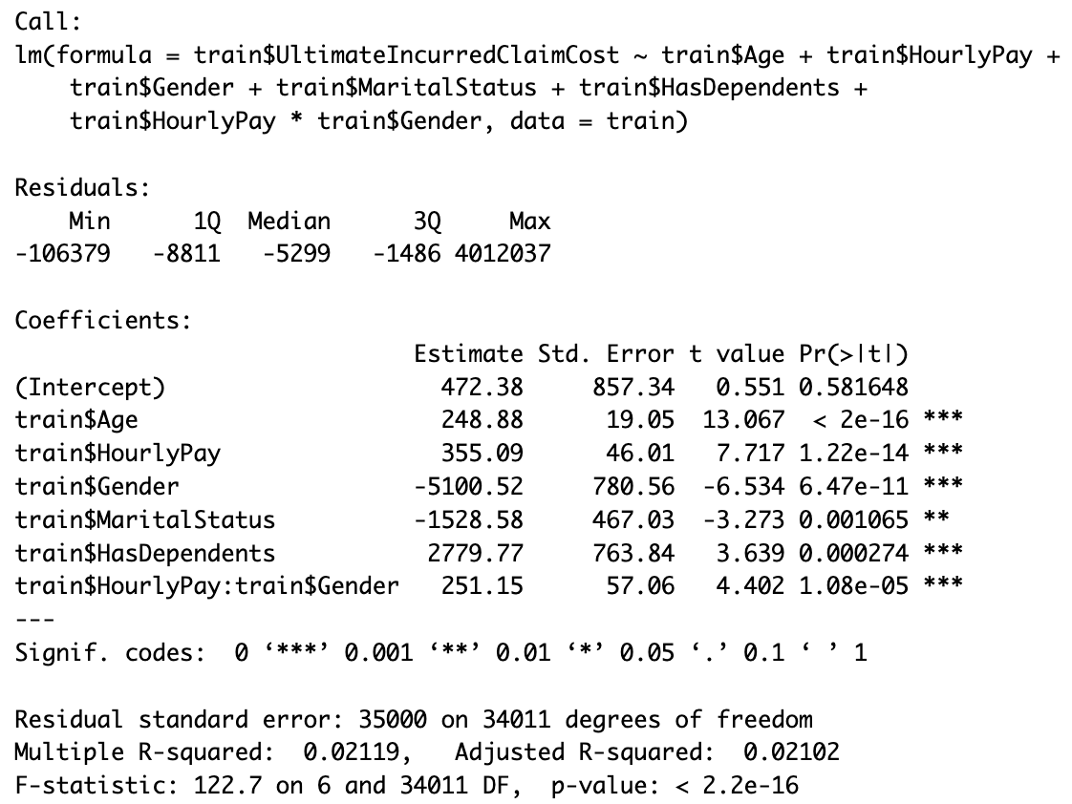
Linear Regression Model
The final Linear model included an interaction between Hourly
Pay and gender.
Based on the high residuals and Residual standard error, it is apparent that the linear model is a very inaccurate when predicting the Claim Cost.
This is likely because the data contains extreme outliers, and is not transformed which throws off the model to a large degree

Slide 19
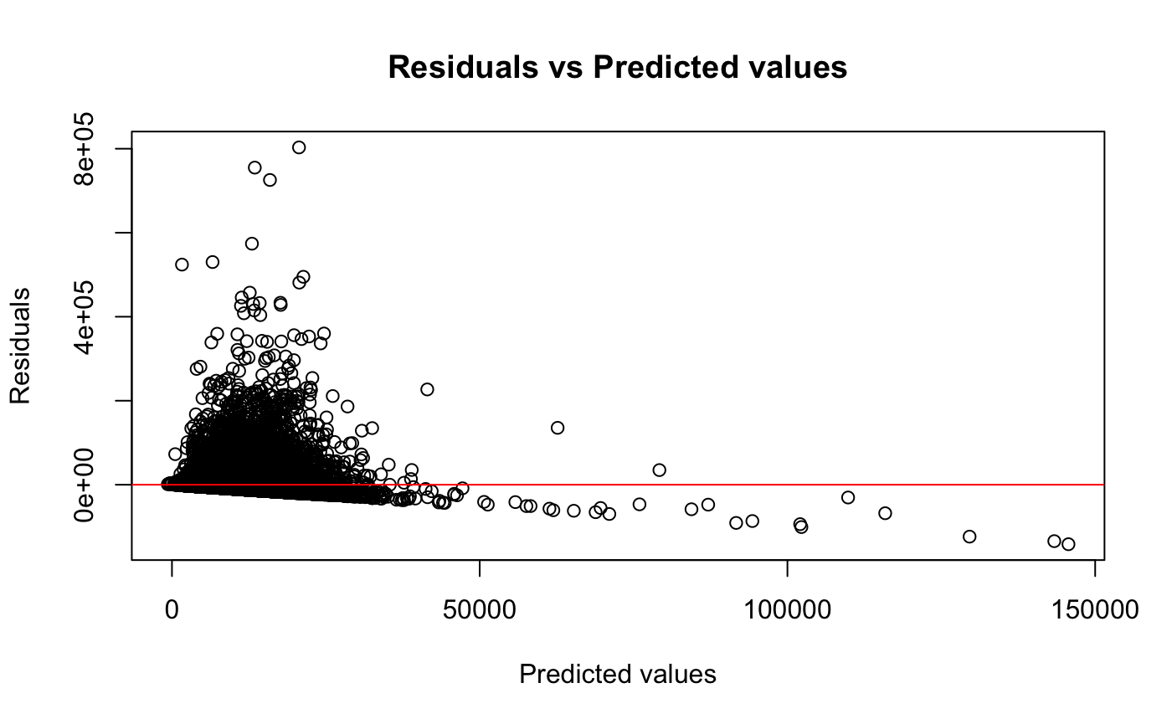
Checking Linearity
Because there is some shape in the residuals plot and it is not randomly distributed, we see there is a non-linearity between the predictions and actual outcomes

Slide 20
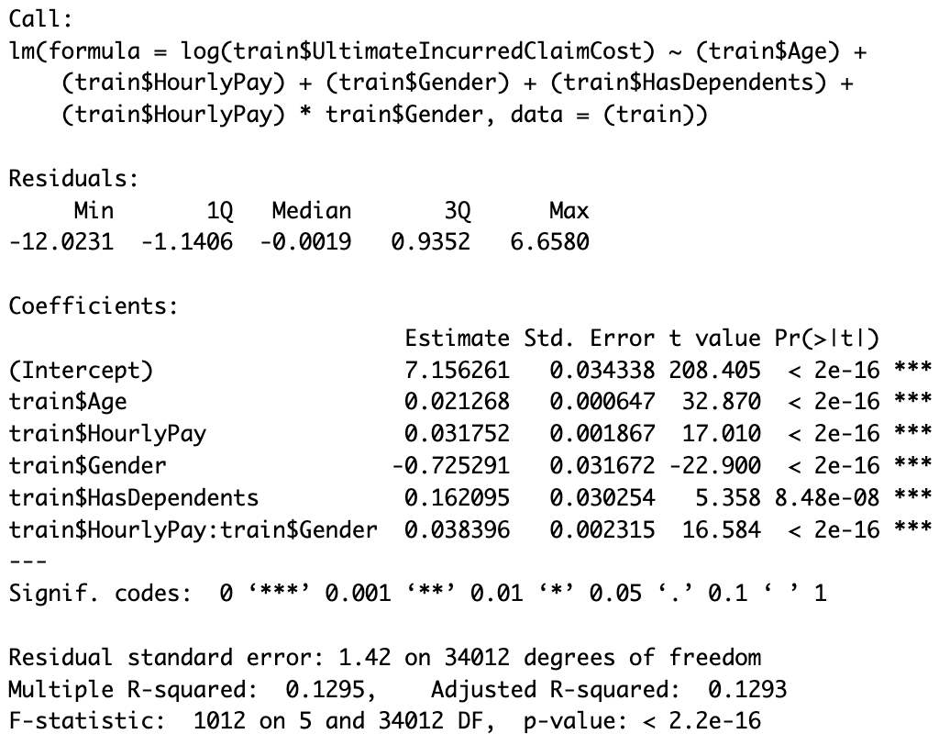
Linear Regression Model-Log Transformation
This is the same model as the original linear regression except with a
Log transformation applied to the outcome variable.
Here we observe the Residuals are extremely small, with a median of -0.0019 and a standard error of 1.42
The p-values are also extremely small, indicating all the explanatory variables have a significant impact on the outcome variable.
This is a much better fit and provides more accurate predictions.

Slide 21
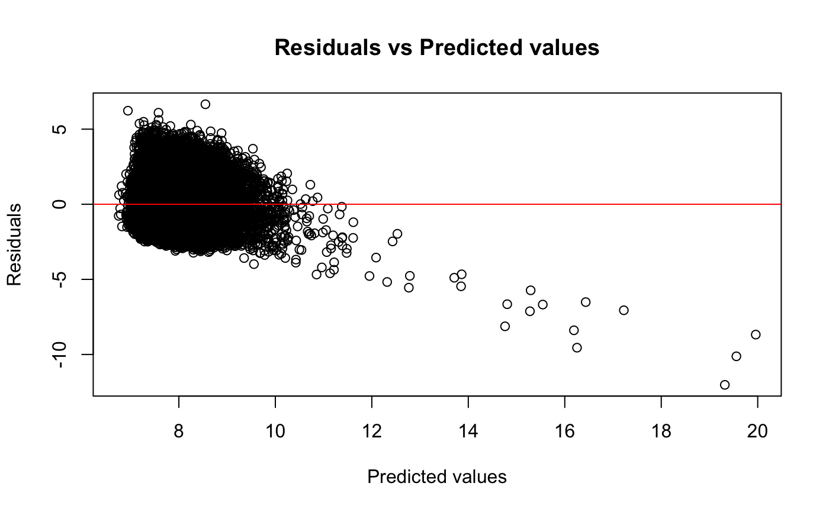
Checking Linearity
Again, we see some shape in the residuals plot, however it is very concentrated around a residual value of 0. Therefore, we can still assume non-linearity between the predictions and actual outcomes, as the model more accurately predicts values closer to the mean and inaccurately predicts outliers.

Slide 22
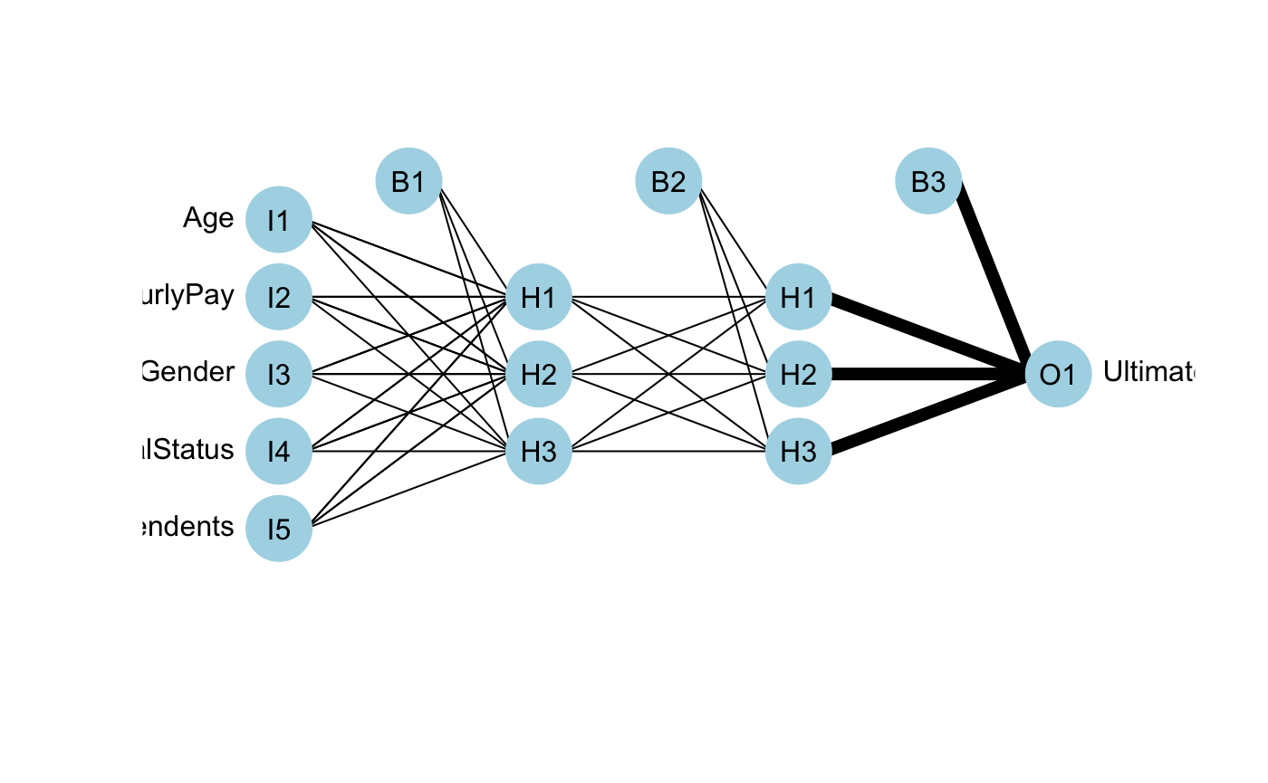
Neural Network
The neural network is run with all explanatory variables, with no interactions.
The threshold of 0.01 means that when the change resulting from the error function is less than 0.01, it stops training.
The network also has 2 hidden layers, each with 3 neurons.
The far left nodes are initial input variables.
The middle nodes are the 2 layers of 3 neurons each, which process the data from input variables
The lines connecting the inputs and neurons are weights, which are optimized during the 5 training repetitions
Hourly Pay
Final Claim Cost
Marital Status
Has Dependents
Finally, the B1, B2, and B3 are bias nodes, which are constant values representing an error margin like intercepts or error terms in a linear model

Slide 23
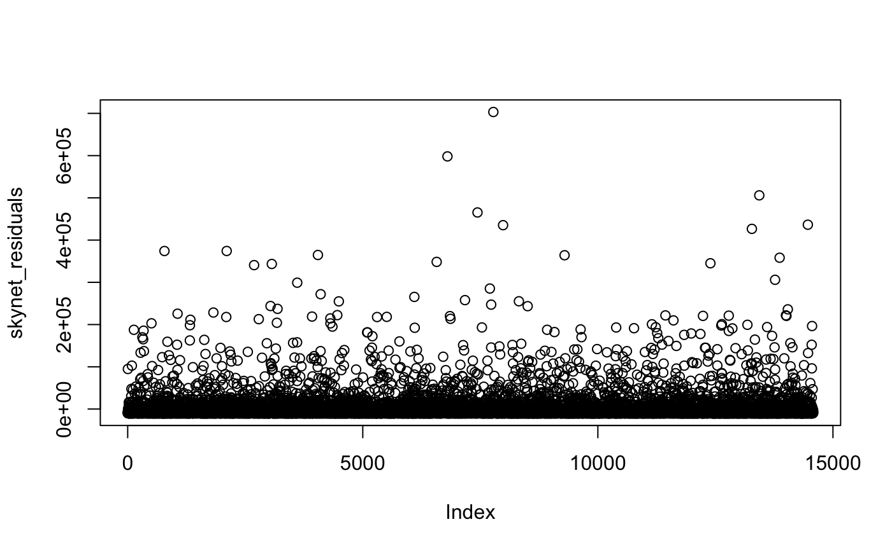
Residuals
The residuals are more evenly distributed along the X-axis
Because the residuals are fairly linear, there is no heteroscedasticity.

Slide 24
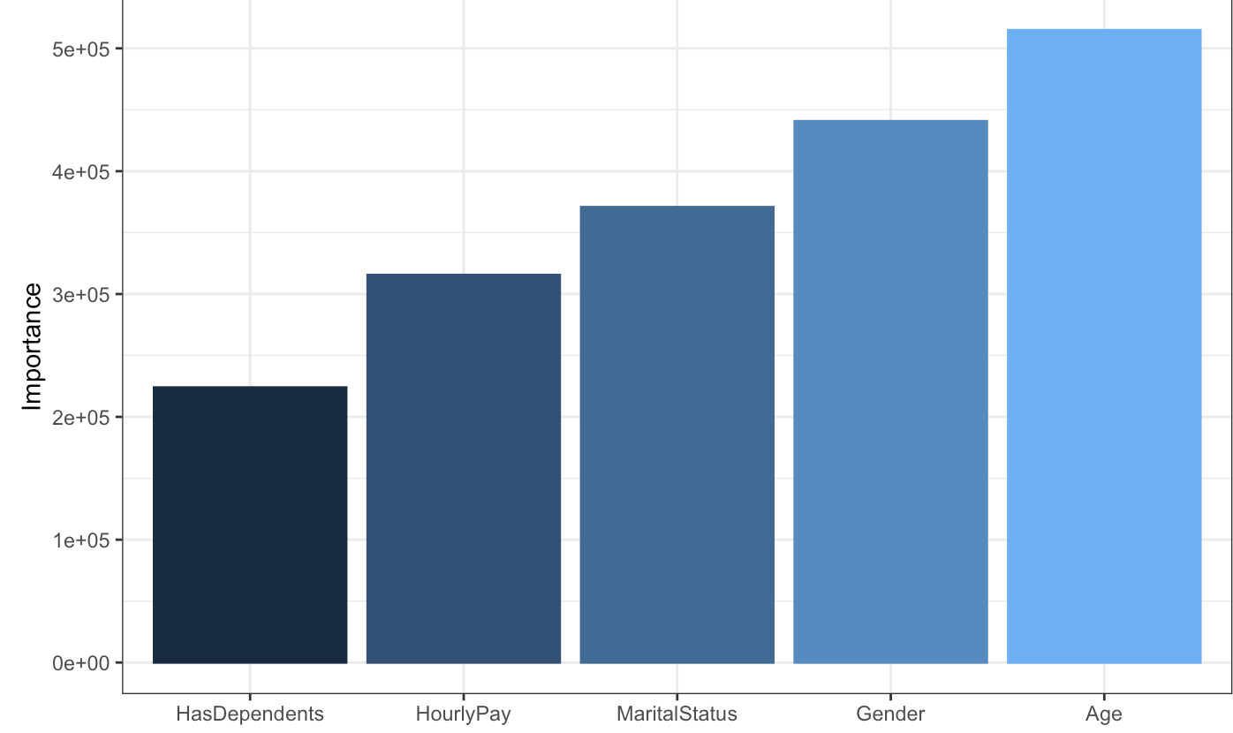
Olden
This returns the importance of each Explanatory variable, or Input.
A positive value indicates that the variables are Positively correlated with the Outcome
Notes:
This weights relative importance of each explanatory variable

Slide 25
Best Model
 | R^2 | AIC | BIC | RMSE | Median Residual | Residual Standard Deviation
Linear regression | 0.021 | 808,421 | 808,488 | 27,944 | -5,299 | 35,000
Log-Linear regression | 0.129 | 120,427 | 120,487 | 1.6 | -0.0019 | 1.42
Neuralnet | NA | NA | NA | 27,700 | -7,434 | 27,700
Based on the model evaluations, the Log-Linear Regression likely provides the most reliable predictions. This scores the best in every category, and unlike the Neural net is easier to understand as its predictions are not from a “black box.”
An Interesting side note, the most important variables according to the Neural Network are Age, Gender and Marital Status in that order.
However, the most important variables according to the linear models are Gender and if the person has Dependents.
Notes:
Keep in mind, results of log model must be transformed out of log form. So for example with an output of “4”, our actual result would be 10^4.

Slide 26
Case studies
Has Dependents | Hourly Pay | Gender | Age | Estimated Claim
Yes | 35 | Male | 30 | 376.52
No | 30 | Female | 25 | 30.48
No | 25 | Male | 20 | 28.45
Predicted Claim Cost for given inputs
Notes:
These are some examples with the log transformed linear model, here you can see how age and hourly pay increase the estimated claim amount

Slide 27

Thank you
Questions?
Concerns?
Notes:
Elicit LOL’s

Slide 28


